Slide 1
Design and Analysis of Algorithms Assignment 1
IIT2019030 Kaushal Kumar
IIT2019031 Sarvesh
IIT2019032 Aarushi

Slide 2
Introduction
generate a 2D matrix, with 2 digit positive integer value and accordingly generate its frequency distribution table along with the position of each value as situated in the generated matrix.
Here, we have used hashing techniques to store the frequencies of the elements in an array and mapped their values to the positions in which they are situated.
To store the key/value pair, you can use a simple array like a data structure where keys (integers) can be used directly as an index to store values.
The mapping is done using a 2D vector and pair to store x-y indexes.

Slide 3
Application
Basically, Hashing is the transformation of a string of characters into a usually shorter fixed-length value or key that represents the original string. Hashing is used to index and retrieve items in a database because it is faster to find the item using the shorter hashed key than to find it using the original value
For the implementation of hashing concept, we can use map or simply we can use an array to keep track of the values that have occurred during the iteration of the given 2-D Array but in some cases the array won’t work, like in case when maximum element is greater than the MAX size of Array(~10⁶ - 10⁷).
So here we can use the map which has a key,value pair so that the unnecessary wastage of size can be prevented.

Slide 4
Algorithm Design
Algorithm 1
1.) Use a frequency array(freq) to store the frequencies of the elements of the matrix.
2.) Store the indexes of elements using a 2D vector of type int and a pair of int values to store x and y indexes.
3.) In the vector store the values correspondingly, and display it through looping over the entire 2D vector.
Algorithm 2
Here, we are using Map instead of frequency array which makes our algorithm more efficient with respect to space.

Slide 5
Pseudo Code
function Main()
max ←1000000
Get n,m
a[n+1][m+1]
Get random inputs
vector<vector<pair<int,int> > >v(max)
map<int,int>m
for i←1 to n do
for j←1 to m do
m[a[i][j]]←m[a[i][j]]+1
v[a[i][j]].push_back(i,j))
for i←1 to 100 do
if(m[i]) then
for j←1 to v[i].size()do
print v[i][j].first
print v[i][j].second
return 0

Slide 6
Code
for(int i=0; i<10004; i++)
freq[i]=0;
for(int i=1; i<=n; i++){
for(int j=1; j<=m; j++){
freq[a[i][j]]++;
v[a[i][j]].push_back(make_pair(i,j));
}
}
for(int i=0; i<=1000; i++){
if(freq[i]){
cout<<"frequency of "<<i<<"->"<<freq[i]<<" "<<"and"<<" "<<"locations are"<<"->";
for(int j=0; j<v[i].size(); j++){
cout<<"("<<v[i][j].first<<","<<v[i][j].second<<")"<<" ";
}
cout<<endl;
}
}
return 0;
}
#include<bits/stdc++.h>
using namespace std;
int main(){
int n,m;
cin>>n>>m;
int a[n+2][m+2];
srand(time(0));
for(int i=1; i<=n; i++){
for(int j=1; j<=m; j++){
int k = 10 + rand() % ((100) - 10);
a[i][j] = k;
cout<<a[i][j]<<" ";
}
cout<<"\n";
}
vector<vector<pair<int,int> > >v(1004);
int freq[10004];

Slide 7
Complexity Analysis
Time complexity
In all the cases, time complexity will always be same as O(n*m). As we have to do the 3 computations:
first begin the generation of random arrays.
Second being the computation of frequency array and the last one is print the frequency array. For first and second Computation, time complexity is always O(n*m).
For third computation, time complexity is equals to the O(no. of distinct elements*respective occurrence) and ultimately this comes as the O(n*m) So overall time complexity is O(n*m).

Slide 8
Space Complexity
The complexity of both the algorithm is almost same for small inputs which is generally O(n*m) but for large inputs algorithm 2 is more efficient than algorithm 1 because it will reduce unnecessary wastage of memory and solve the problems in O(n*m) complexity.

Slide 9
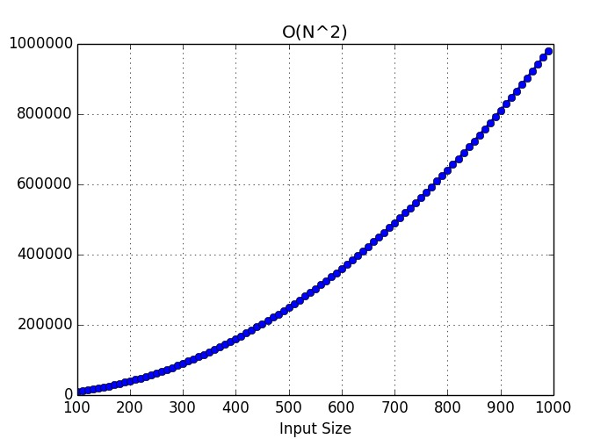
Experimental Study
Apriori Analysis:
Apriori analysis means, analysis is performed prior to running it on a specific system. This analysis is a stage where a function is defined using some theoretical model. Hence, we determine the time and space complexity of an algorithm by just looking at the algorithm rather than running it on a particular system with a different memory, processor, and compiler.

Slide 10
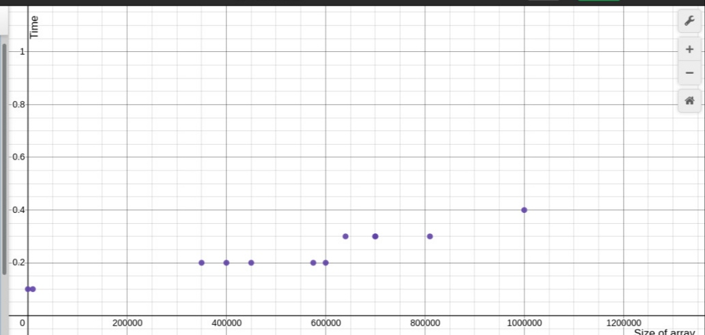
Aposteriori Analysis:
Apostiari analysis of an algorithm means we perform analysis of an algorithm only after running it on a system. It directly depends on the system and changes from system to system.
So for the a aposteriori analysis of the algorithm, we have run our code on the compiler and get values of the time by specifying the value of n and m and different value of the time had occur.

Slide 11
Reference table for Aposteriori Analysis:
S.No | Sizeof array(n*m) | Time Taken
1 | 1 (1,1) | 0.10000
2 | 10,000 (100,100) | 0.10000
3 | 3,50,000 (350,1000) | 0.200000
4 | 4,00,000 (400,1000) | 0.200000
5 | 5,75,000 (575,1000) | 0.200000
6 | 6,40,000 (640,1000) | 0.30000001
7 | 7,00,000 (700, 1000) | 0.30000001
8 | 8,10,000 (810,1000) | 0.30000001
9 | 10,00,000 (1000,1000) | 0.40000000
10 | 4,50,000 (450,1000) | 0.20000000
11 | 6,00,000 (600,1000) | 0.20000000
12 | 7,00,000 (700,1000) | 0.30000001

Slide 12
THANK YOU

